Slide 1
Tagore Half-Bridge (HB) GaN EVB:
Tagore Technology
12 May 2022

Slide 2
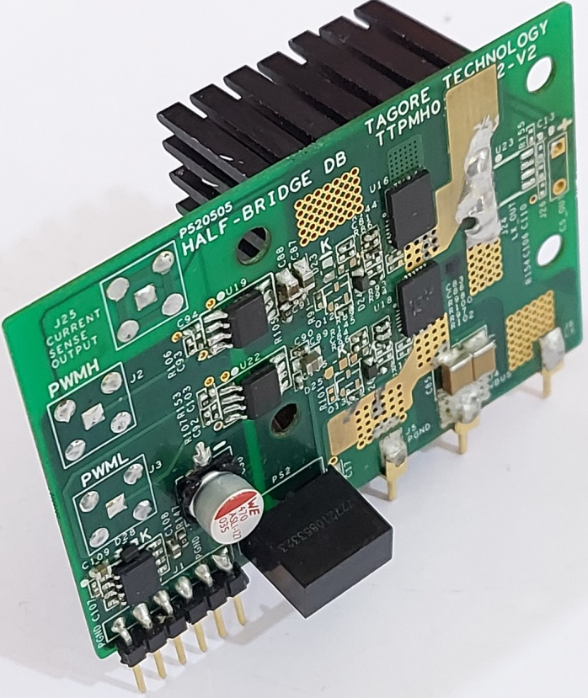
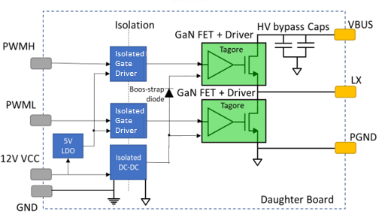
Tagore GaN Half-Bridge EVB Overview – GaN HB Daughter Card
Isolated Half-Bridge using Tagore’s 650V GaN FETs with integrated driver IC TP44x00NM.
Isolated Gate drivers for both high-side and low side device.
+5V/0V PWM inputs.
Isolated DC/DC converter for low side driver.
Bootstrap supply for high-side driver.
Heat sink mounted on the back side of the PCB.
Power connector pin for Vbus, GND and Lx.
Header pin for 12V DC input and PWM inputs.
4 layers FR4 board design.
Board size of 2.6’’x1.7’’x1.25’’ including heat sink.

Slide 3
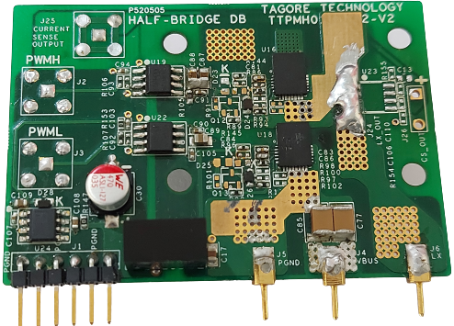
Half-Bridge GaN EVB – GaN Daughter Card Details
Isolated gate drivers
LV side to HV side
Isolation boundary
LV Side
HV Side
HS GaN
Tagore GaN
TP44100NM
LS GaN
Decoupling
Capacitors
(Ceramic)
12V – 12V Isolated DC-DC converter
P_GND
VBUS
LX
PCB Edge connector
(Bias Supply and
PWM Pins)
Power Pins

Slide 4
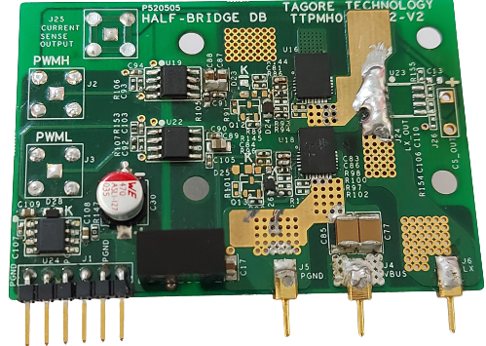
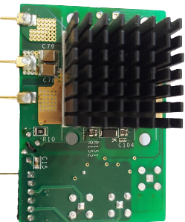
Half-Bridge GaN EVB – GaN Daughter Card Details
Heatsink
Front side
Rear side

Slide 5
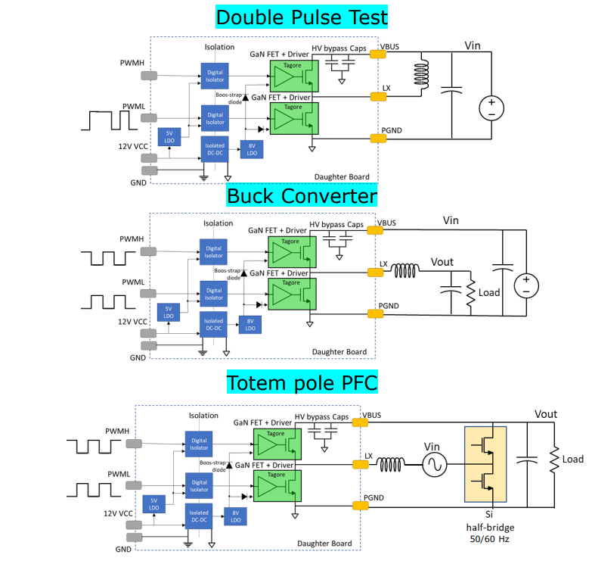
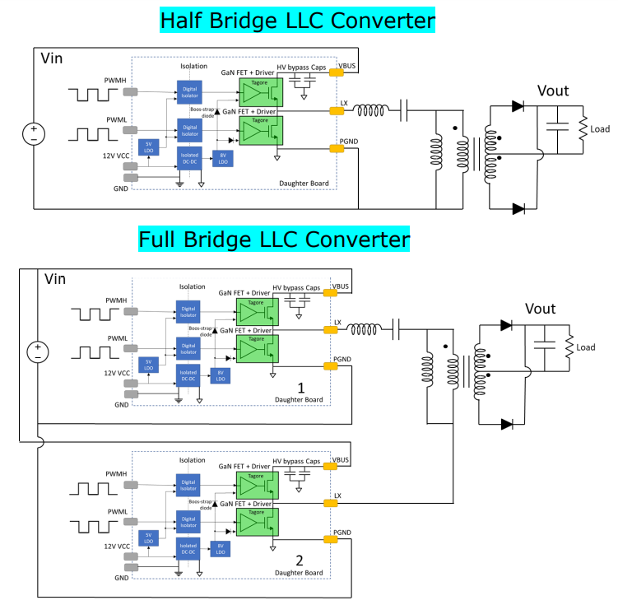
Tagore GaN HB EVB – Example Use Cases

Slide 6
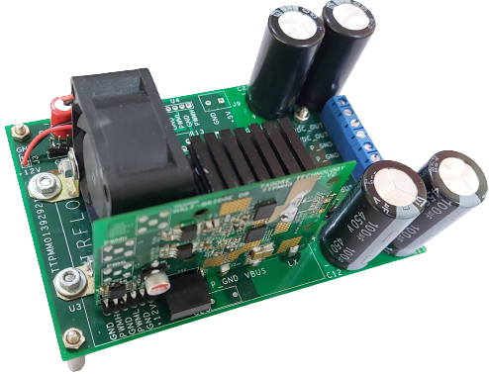
Tagore GaN HB EVB – How to Use ? (Mother Board Introduction)
The GaN HB can be tested stand alone. However, it is recommended
to use a dedicated mother board to test the HB EVB. The HB daughter
card can be directly plugged into the mother board, which interfaces
between all the HV/LV input and output voltages/currents.
The block diagram representation of the mother board and the
Daughter card is shown here.
+5V Output for external circuits (if any)
VBUS
LDO
+12V Input
+12V Vcc
C_{HV}
LV Bias supply and PWM input
LX
+12V supply for Fan
HB GaN Daughter Card
PWM_H
Vdc_Out
Mother board
PWM_HS_IN
Dead time generation
PWM_L
C_{LV}
Logic inverter
PGND
GND
The mother board receives a single PWM input (for HS GaN).
The PWM pulses for LS GaN, and the dead time (adjustable) between
the HS and LS GaN’s are generated in the mother board.
VBUS
PGND
LX
Vdc_Out
Power circuit Interface (HV)

Slide 7
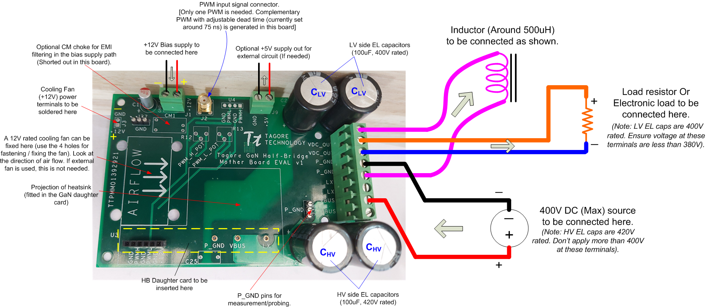
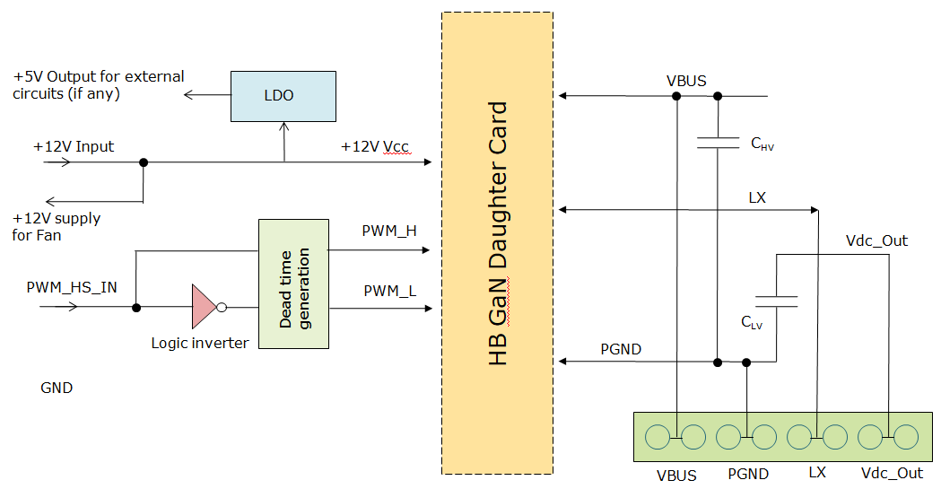
Half-Bridge GaN EVB – Mother Board Details.
+5V/0V
(HS PWM)
(LS)
Power circuit Interface (HV) cables

Slide 8
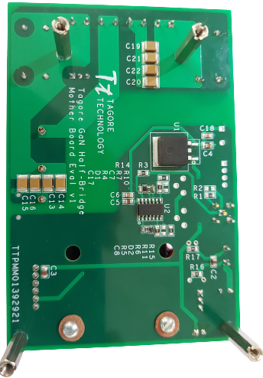
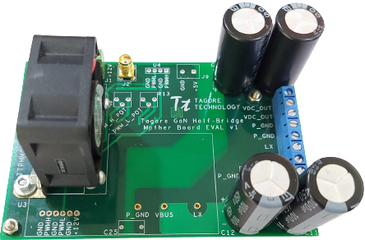
Half-Bridge GaN EVB – Mother Board Details.
5V Linear Regulator IC
Nand Gate IC for complementary PWM, and Dead time generation
Top side
Bottom side
HV MLCCs

Slide 9
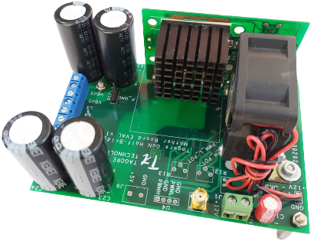
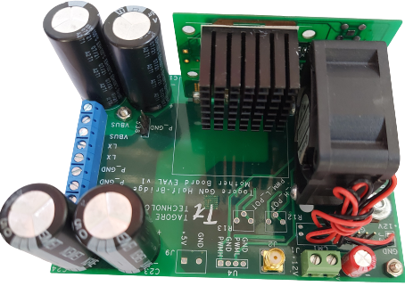
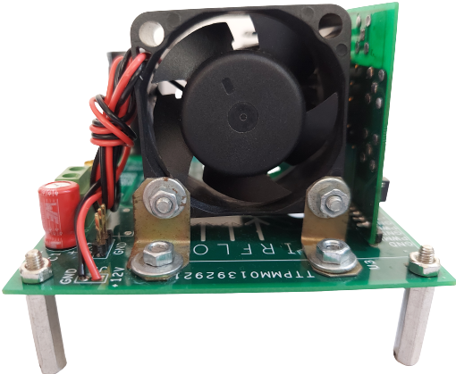
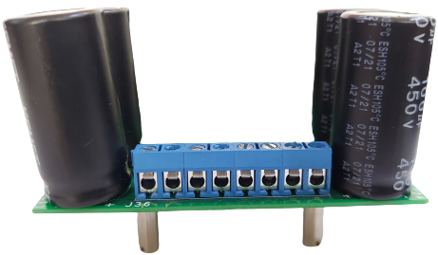
Complete Tagore’s HB GaN EVB – Daughter Card Plugged into Mother Board

Slide 10
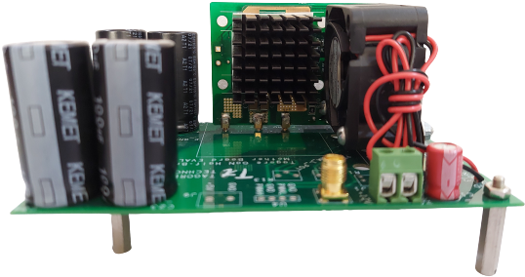
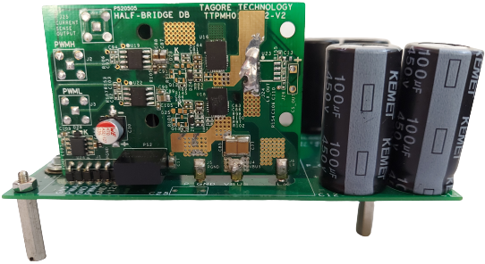
Complete Tagore’s HB GaN EVB – Daughter Card Plugged into Mother Board

Slide 11
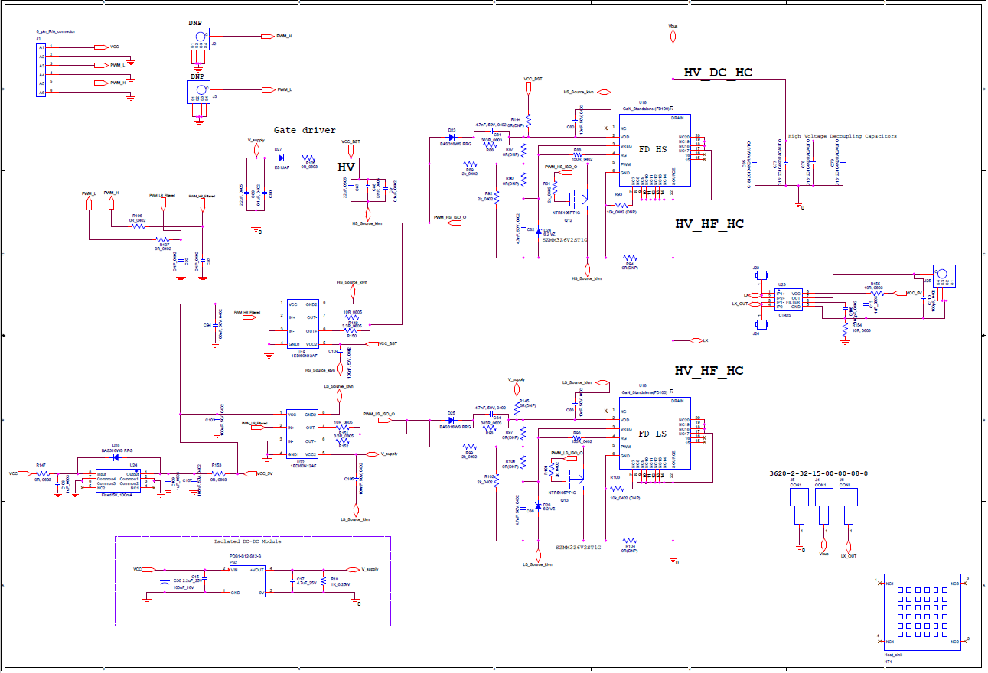
Half-Bridge GaN EVB – Daughter Card Schematic

Slide 12
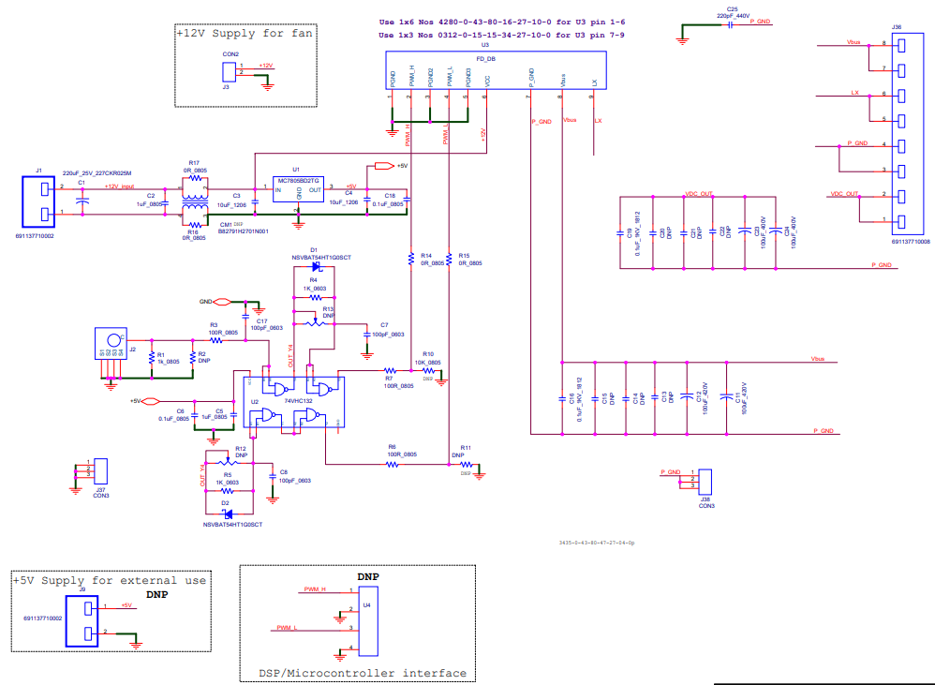
Half-Bridge GaN EVB – Mother Board Schematic

Slide 13
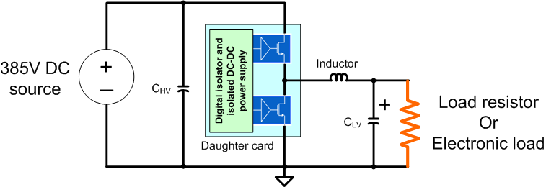
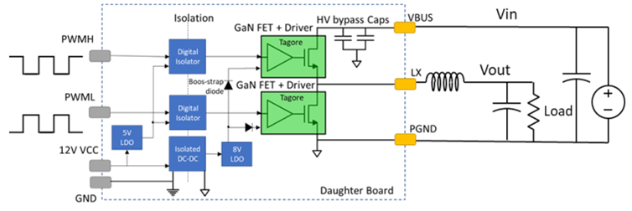
Half-Bridge GaN EVB Application – DC-DC Buck Converter
LV Output
(350V Max)
HV Input
(400V Max)
This slide shows an example case, where the EVB can be configured to realize a DC-DC Buck Converter.
The HS GaN acts as the main converter switch, while the LS GaN acts as the synch. Rectifier.
The mother board is used with single PWM input (for HS GaN). The PWM signal for the LS GaN, and the associated dead time (between HS and LS GaN gating pulses) are generated in the Mother board. The dead time can be adjusted by changing two timing resistors. Currently it is set at around 75ns.
LV Output
(350V Max)
HV Input
(400V Max)

Slide 14
Half-Bridge GaN EVB Application – DC-DC Buck Converter
(HS PWM)
(LS)
(> 750uH)

Slide 15
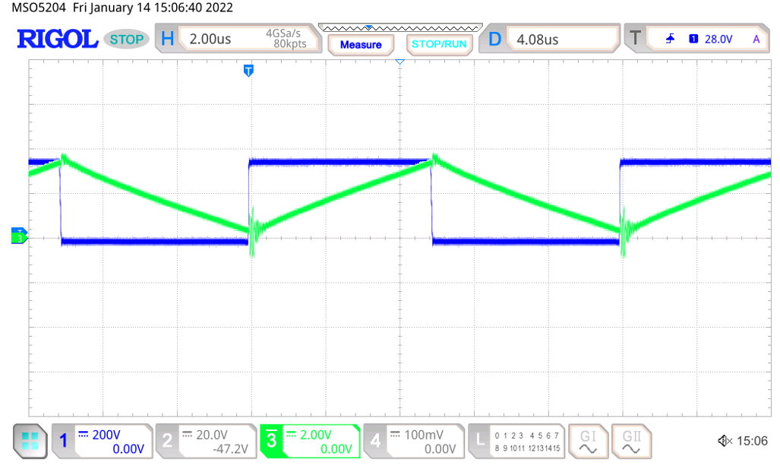
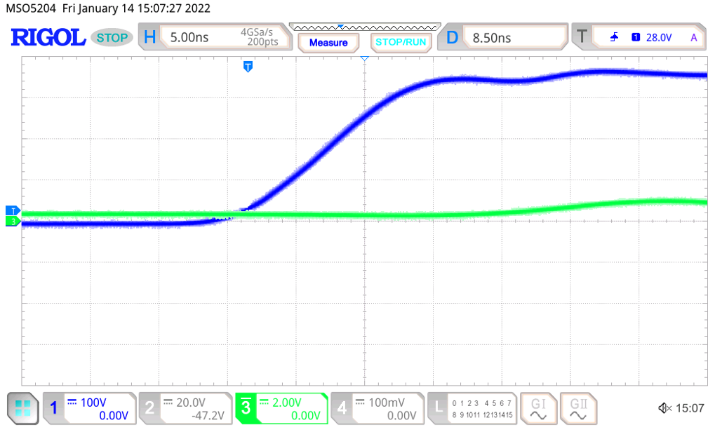
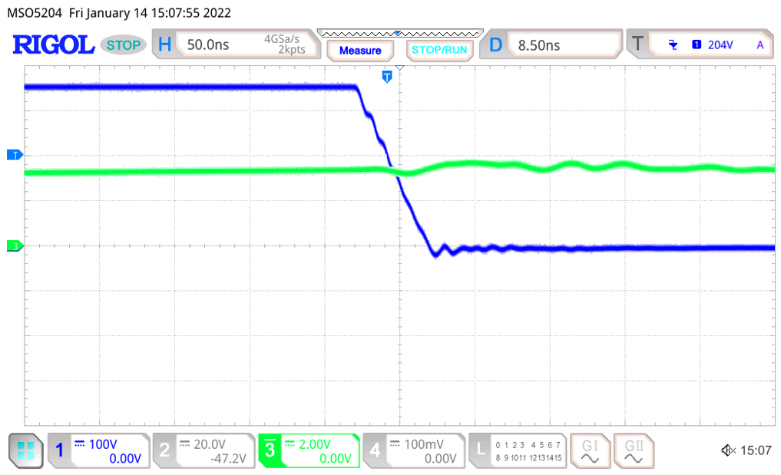
Half-Bridge GaN EVB – Buck Converter Switch Waveform
380Vdc
200uH
190Vdc
200V/div
2A/div
LX
500W
Typical switching instant voltage and inductor current waveforms
Fsw: 100kHz
Dead time: 75ns
Turn on instant of HS GaN
Turn off instant of HS GaN

Slide 16
Half-Bridge GaN EVB – Standard Operation Procedure
Arrange for, a 400V DC source, 500W load resistor, 12V bias supply, 750uH, 4A Inductor, PWM signal source with variable duty cycle and
a cooling fan.
Make the electrical connection as shown in slide 14 (DC-DC buck converter). Keep the 400V DC supply output to 0V and OFF.
Connect the PWM signal generator output to the SMA connector. Set the duty cycle to 48%.
Plug in the daughter card as shown in slides 9 and 10.
Fix two thermocouple probes to the HS and LS GaN to continuously monitor the case temperatures.
Turn on the cooling fan to cool the heat sink fitted on the daughter card.
Gradually increase the HV DC power supply from 0V to 380V, while monitoring the GaN temperatures.
Do the various measurements/probing.
Turn off the HV power supply, if any GaN case temperature exceeds 100 Deg. C open .
The HS and LS GaN dead time is set for 150ns. It can be changed by adjusting the resistors R4 and R5 in the mother board.

Slide 17
Thank You!

